Slide 1
MIDDLETON CHENEY
FOOTBALL CLUB

Slide 2
FIRST TEAM
1938-39
SEASON
OXFORD JUNIOR LEAGUE
AND CUPS

Slide 3
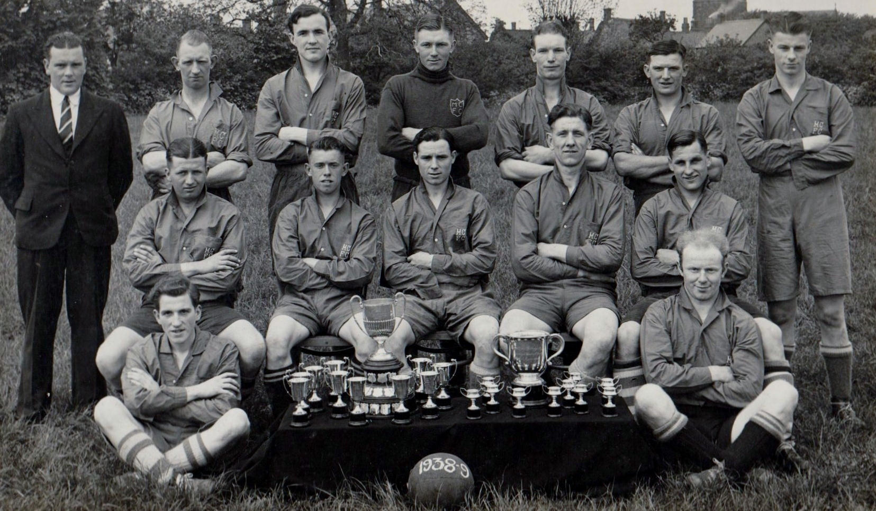
WINNERS
Banbury Charity Cup
Brackley Myers Cup
1938 - 39

